Slide 1
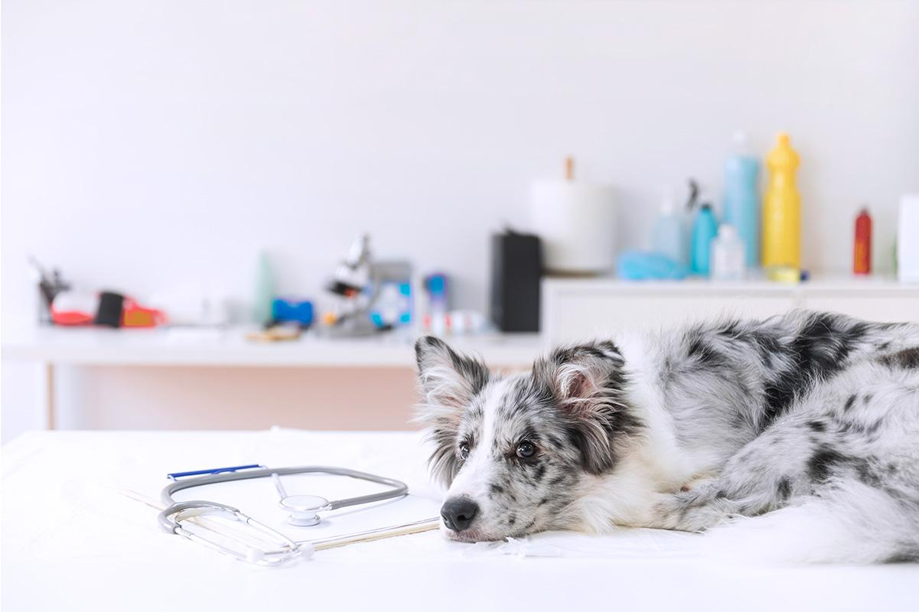
Pet Palace

Slide 2
TABLE OF CONTENTS
01
02
03
ELEVATOR PITCH
CONCEPT
PROCESS
04
05
06
FUTURE DEVELOPMENT
DEMO
DEPLOYED LINKS
Brief Application Overview
User Story and Development Motivation
Technologies, Roles, Challenges, and Successes
Plans for Growth and Improvements
Showcase Application Functionality
Access Live Application

Slide 3
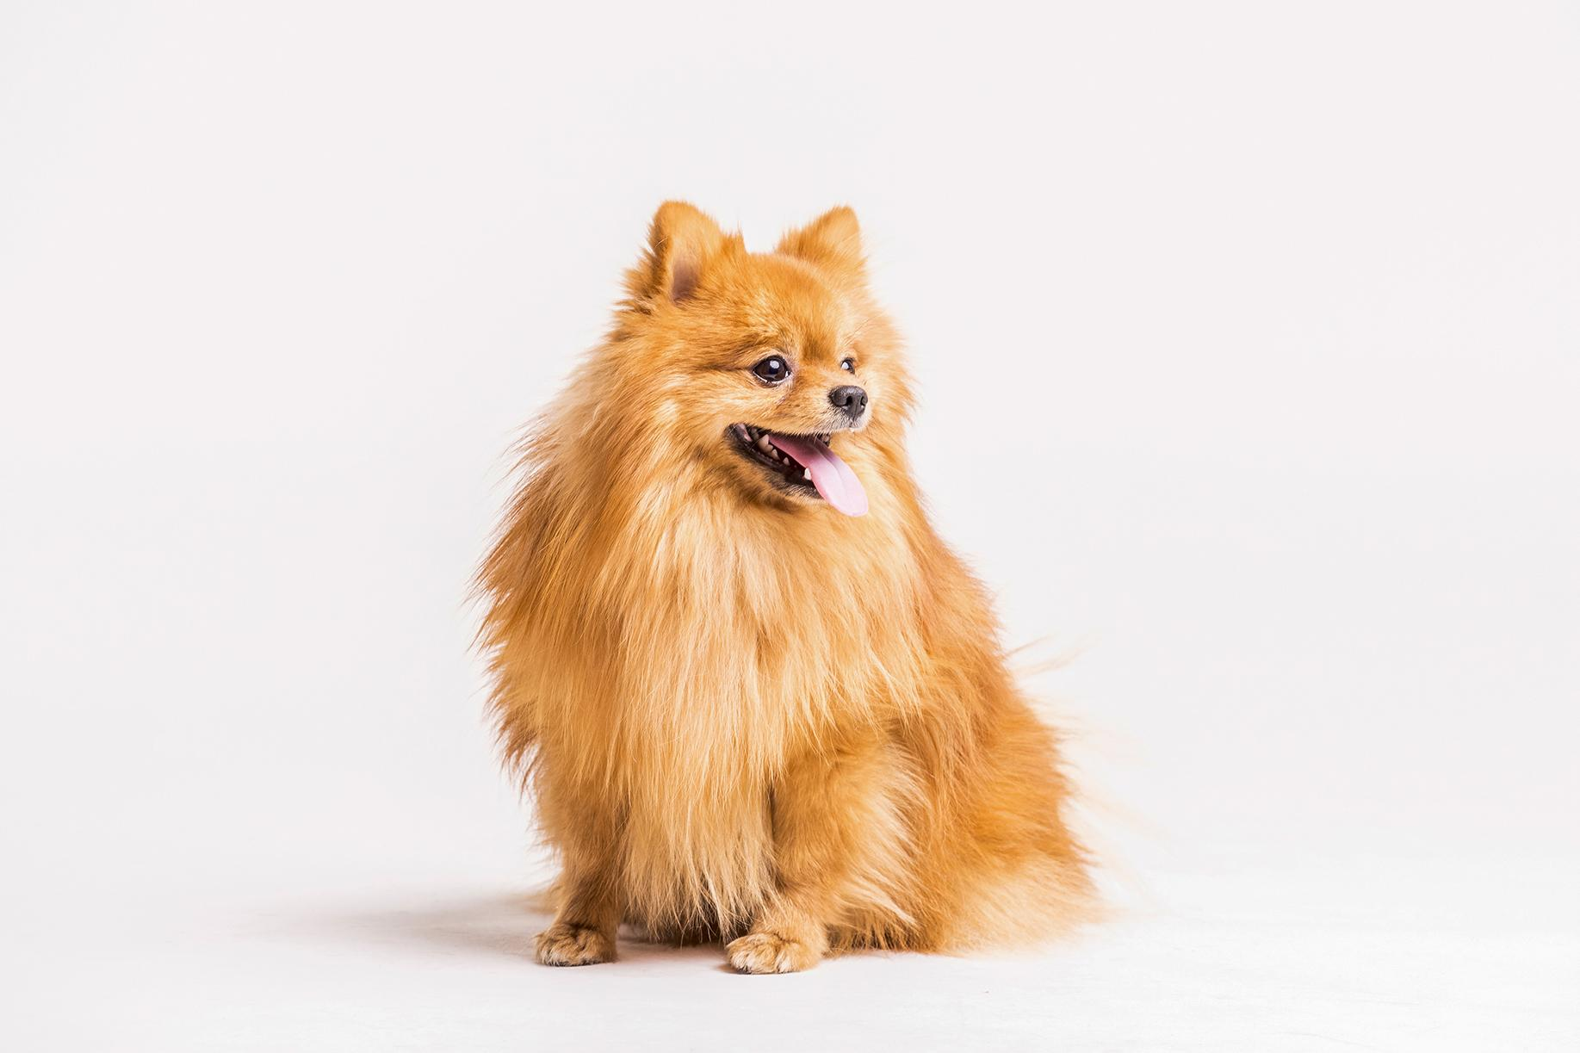
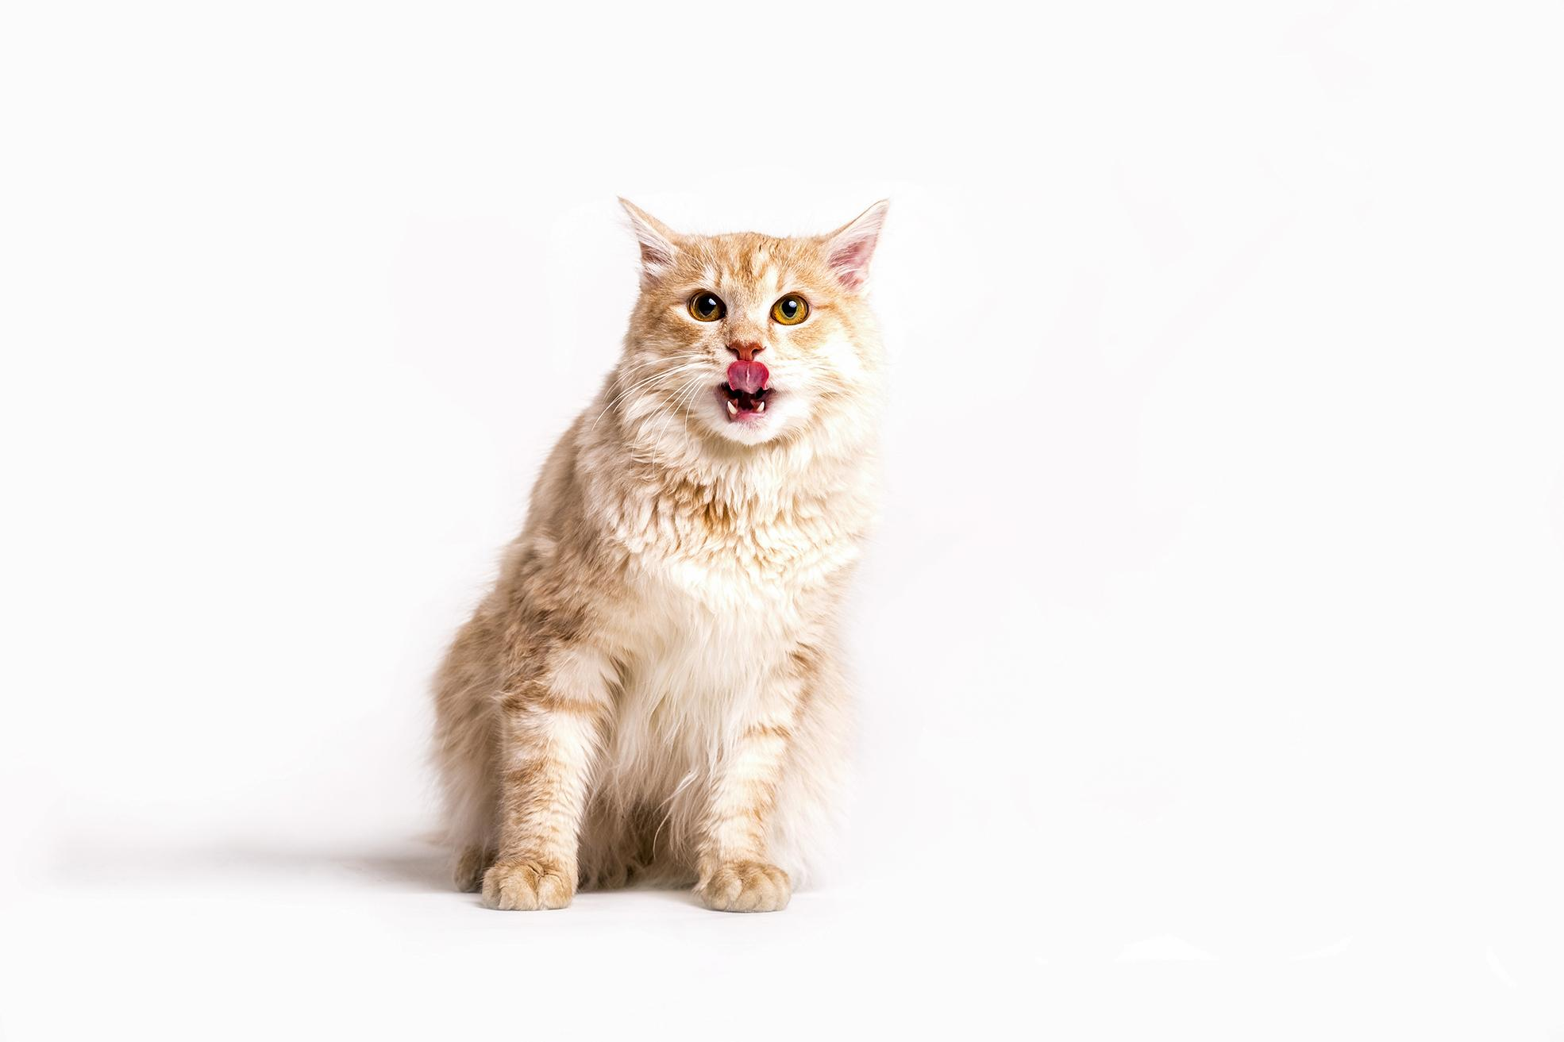
ELEVATOR PITCH

Slide 4
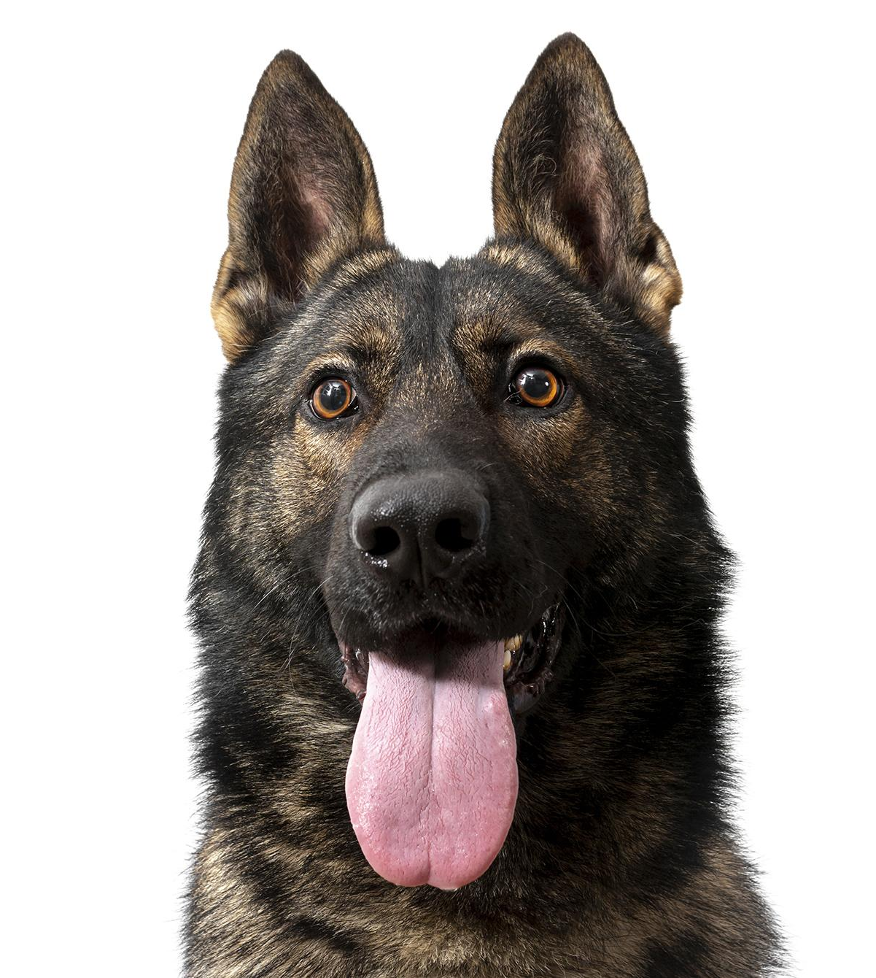
MOTIVATION

Slide 5
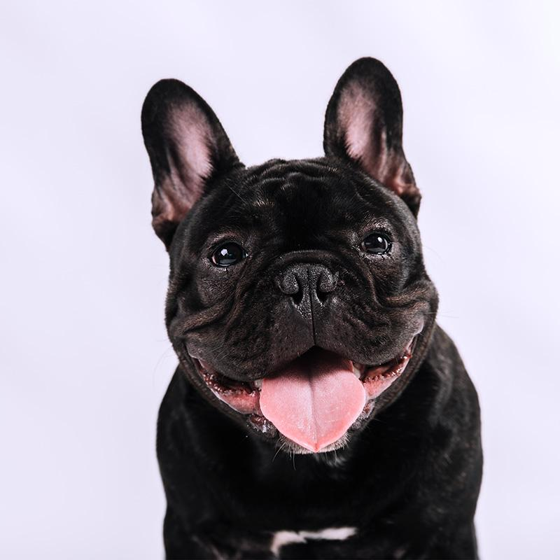
USER STORY
As a pet lover looking to adopt a pet or support animal shelters,
I WANT to be able to access and interact with a comprehensive pet adoption website
SO THAT I can search for pets based on specific criteria, list pets for adoption, save favourite pets, enquire about specifics, and donate to animal shelters efficiently.

Slide 6
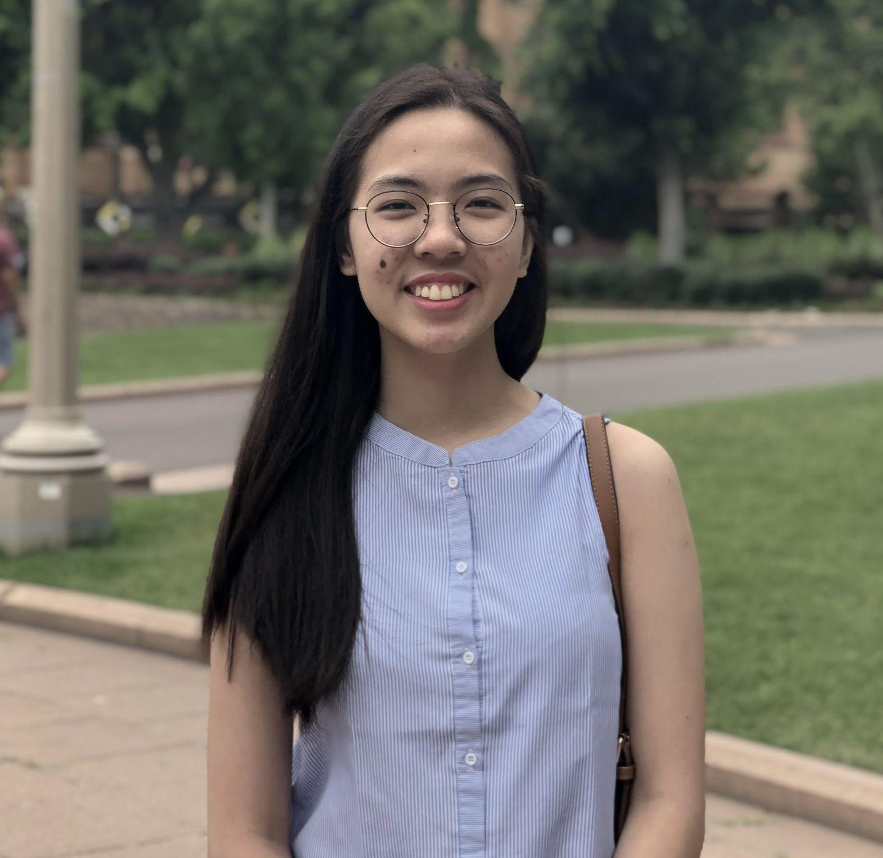
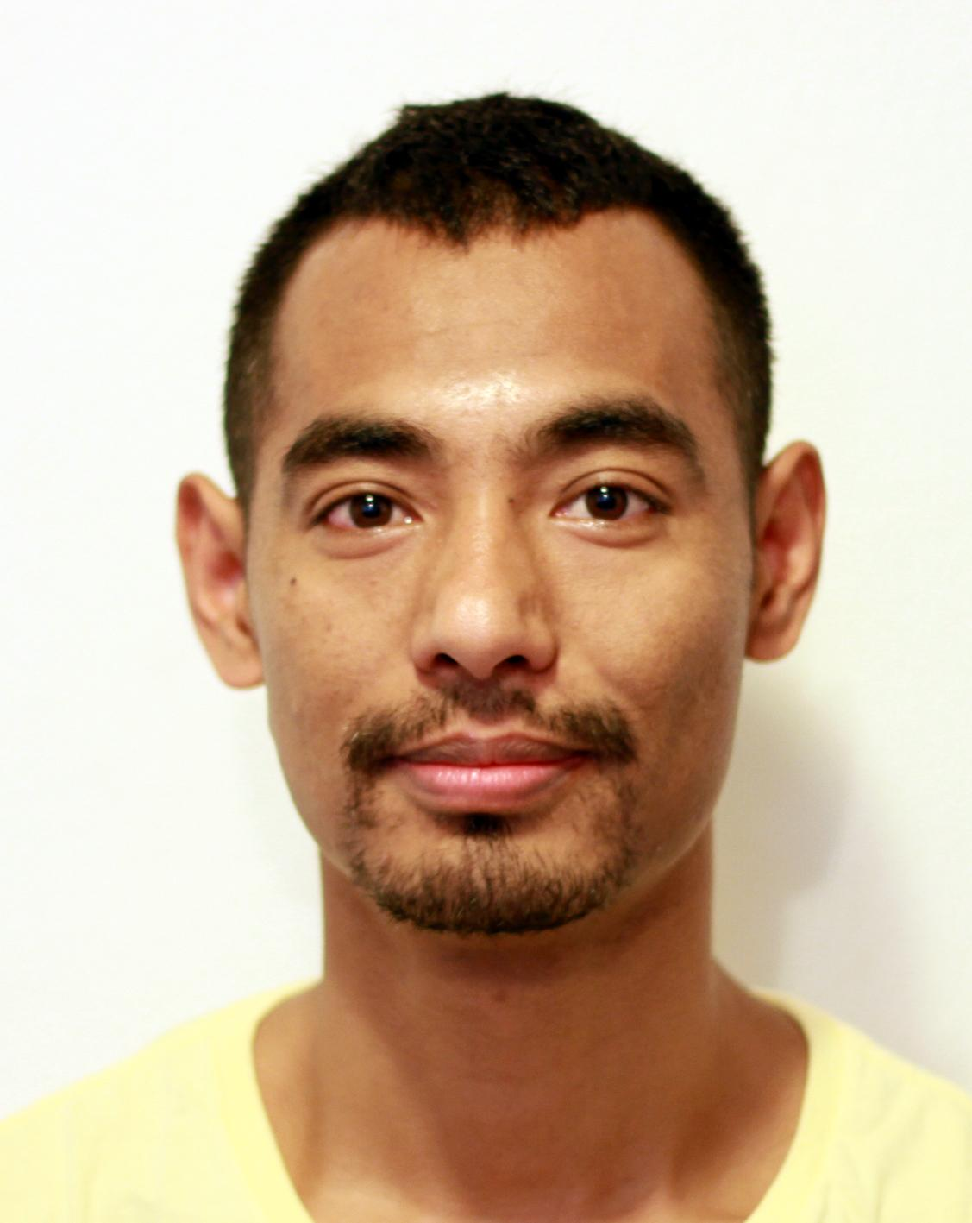
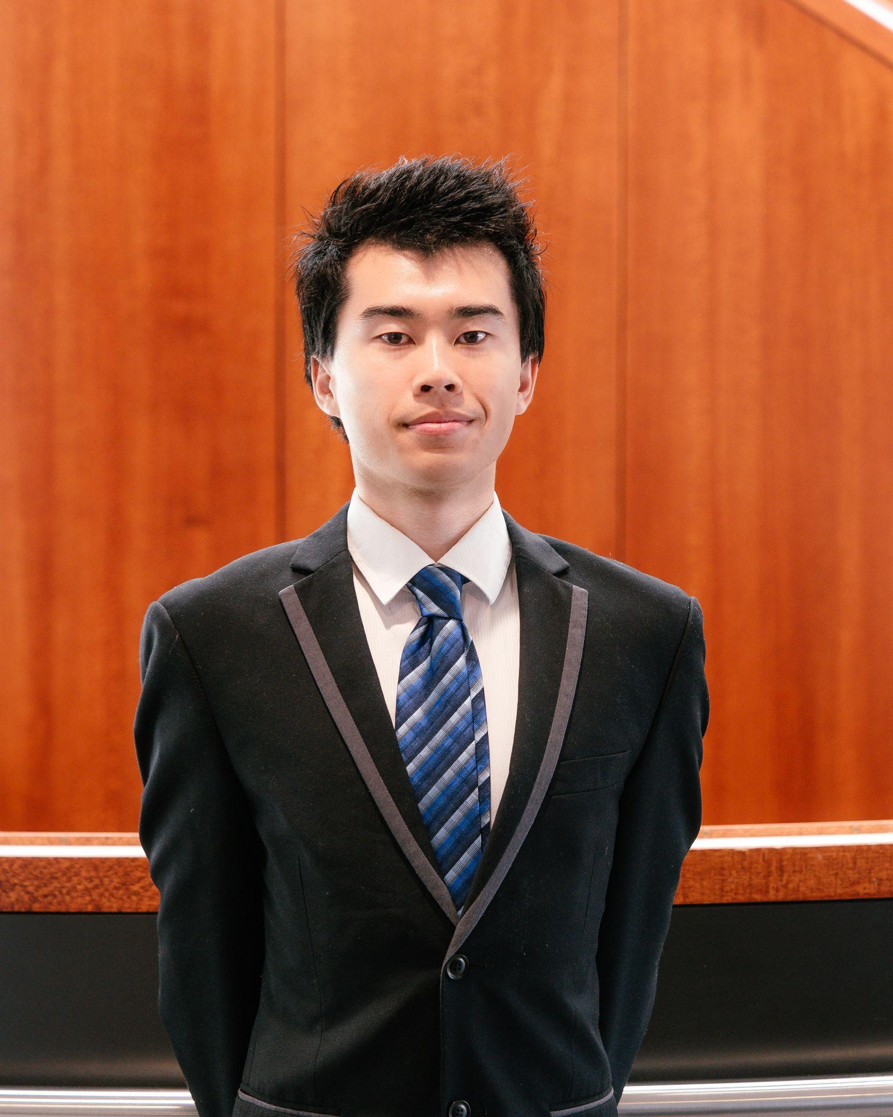
TASKS
JODIE
LEE
SUYASH
MAHARJAN
YUKITOSHI IMAIZUMI-ZHOU
Notes:
Jodie: Front end and Back end -> login signout, pet listing, styling, add favorite pet, remove favorite pet, profile, stripe(failed) etc
Suyash: Full front end,adding other bunch of features etc
Yuki: Full back end, presentation slides, seed datas, stripe, app installation pwa, fixing render issue, readme, stripe (failed)

Slide 7
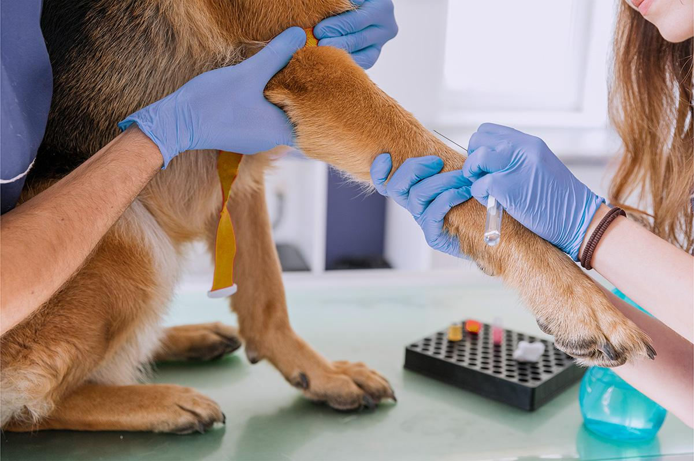
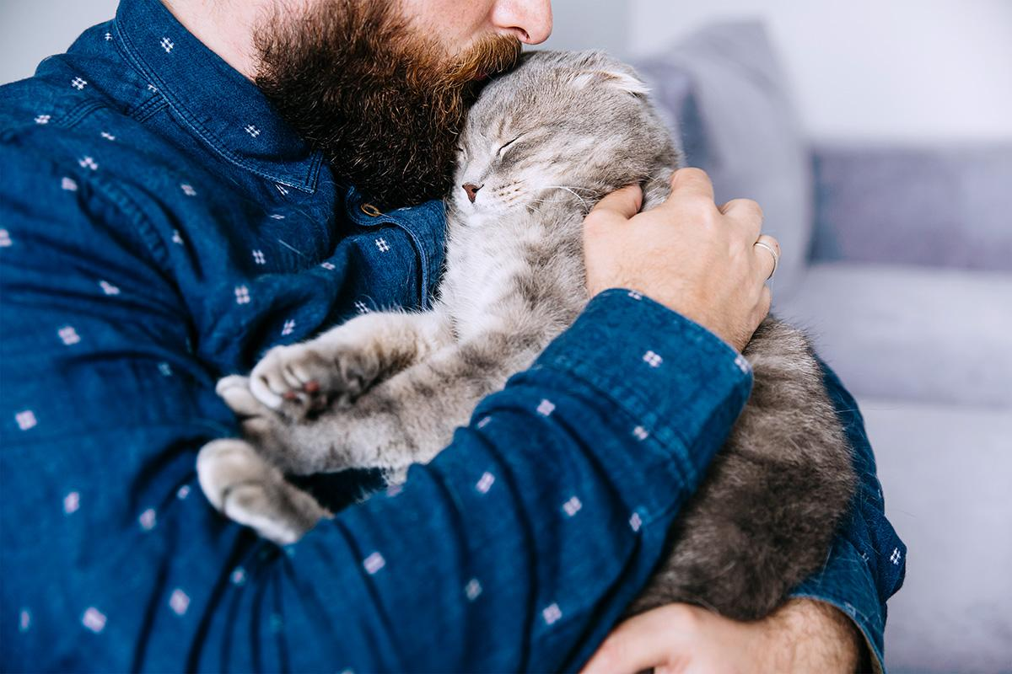
CHALLENGES
SUCCESSES
Render Issue
Conflict when working on same front end page
Query/Data filtering issue
Enquiry - Data Validation incomplete
Time
Created our first mern-stack project
(PWA) App installation working!
Working as a team

Slide 8
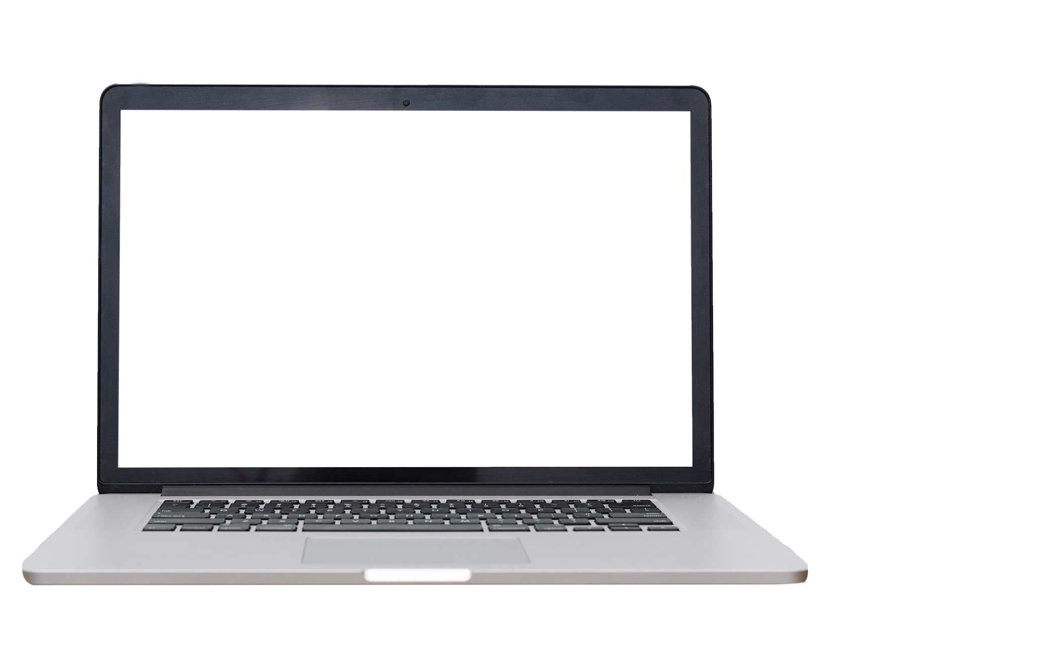

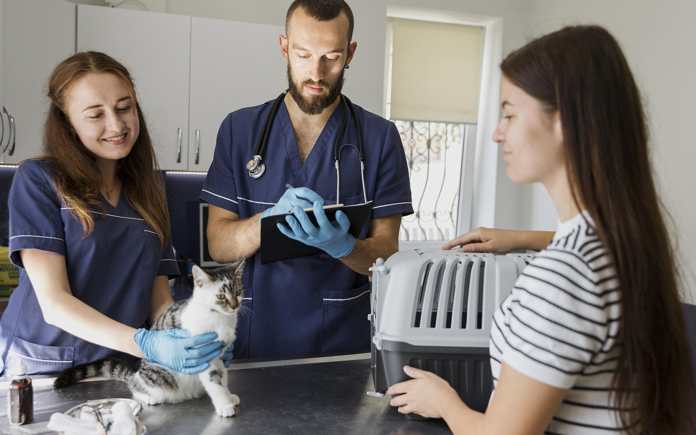




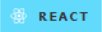

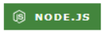

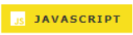
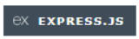

TECHNOLOGIES USED
Database
Front-End
Authentication
Back-end
Notes:
Front End - Daisy ui, tailwind css css react - flowbite - frontend framework
Database: mongodb and mongoose odm
Graphql, node.js and express.js for server
Backend - javascript react router vite
Authentication - jwt

Slide 9
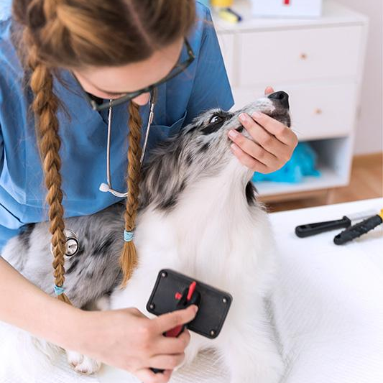
DIRECTION FOR FUTURE DEVELOPMENT
Admin Functionality - develop a comprehensive admin dashboard for CRUD operations.
Filter and search process - users can use search options to easily find the pet that they like
User Profile Updates - enable users to update easily with additional information.
Pet Matching Algorithm - suggest pets based on user preference or lifestyle
Integration of Pet Supply Stores - partner with pet supply stores for purchasing of pet essentials.

Slide 10
DEMO

Slide 11
LINKS
The project was uploaded to GitHub at the following repository: https://github.com/yukitoshi12345/Pet-Palace/
You can access the deployed application here: https://pet-palace-syll.onrender.com/

